Slide 1
Space Exploration: Recent Achievements and Future Missions
A High School Level Presentation
Generated with MarvelAI

Slide 2
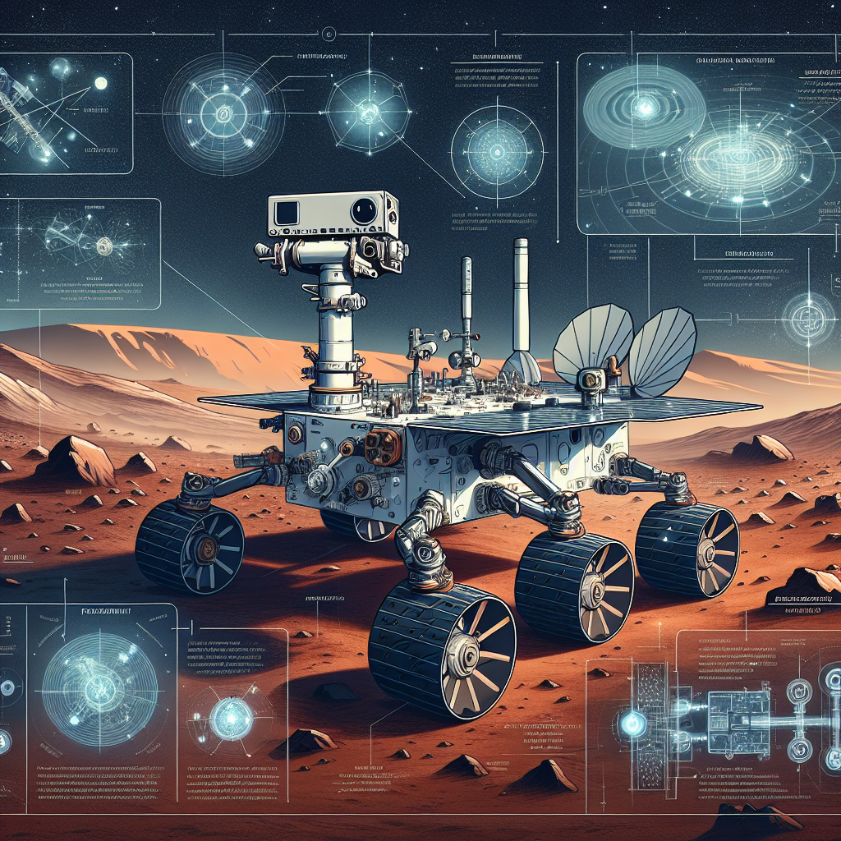
Perseverance Rover: Unearthing Mars' Secrets
Perseverance rover landed on Mars in February 2021, embarking on a historic space mission
The main objective of the mission is to seek signs of ancient microbial life on Mars
The rover collects and stores rock and soil samples for potential future return to Earth
Perseverance carries the Ingenuity helicopter, marking the first powered flight on another planet
Examples:
Perseverance's landing site, Jezero Crater, was chosen because it may have once held a lake, increasing the likelihood of discovering signs of past life
The Ingenuity helicopter has successfully completed several flights, demonstrating the feasibility of aerial exploration on Mars
Discussion Questions:
What implications would the discovery of past microbial life on Mars have on our understanding of life's existence beyond Earth?
How has the successful flight of the Ingenuity helicopter revolutionized space exploration?
AI-generated educational illustration for NASA's Perseverance Mars Mission

Slide 3
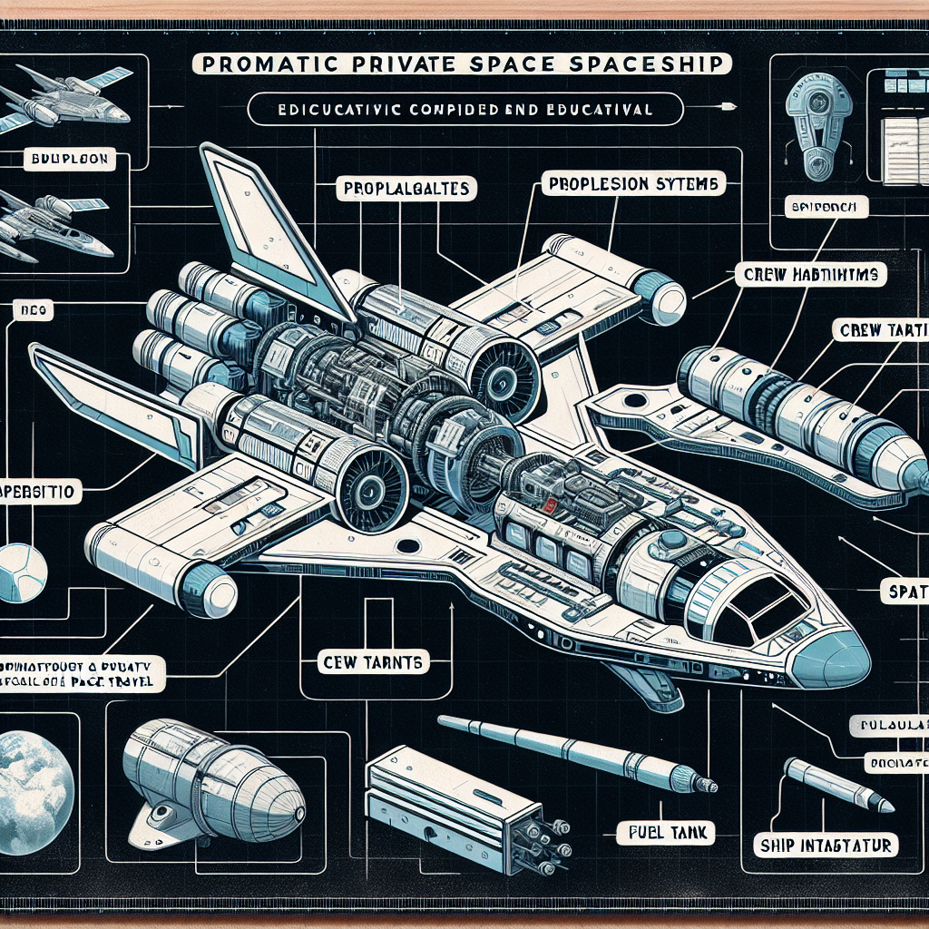
SpaceX's Starship: Revolutionizing Space Travel
Starship is a fully reusable spacecraft currently under development by SpaceX
It is designed for long-duration, interplanetary flights, with Mars as a primary target
Starship can carry up to 100 people, making it suitable for large scale space colonization
The first orbital flight is planned for 2022, marking a significant milestone in space travel
Examples:
Once operational, Starship could drastically reduce the cost of space travel due to its reusable nature
SpaceX's Starship could facilitate Mars colonization by transporting large groups of people and necessary supplies
Discussion Questions:
What impact could SpaceX's Starship have on the future of space exploration and colonization?
How might the development of fully reusable spacecrafts like Starship change our perception of space travel?
AI-generated educational illustration for SpaceX's Starship and the Future of Space Travel

Slide 4
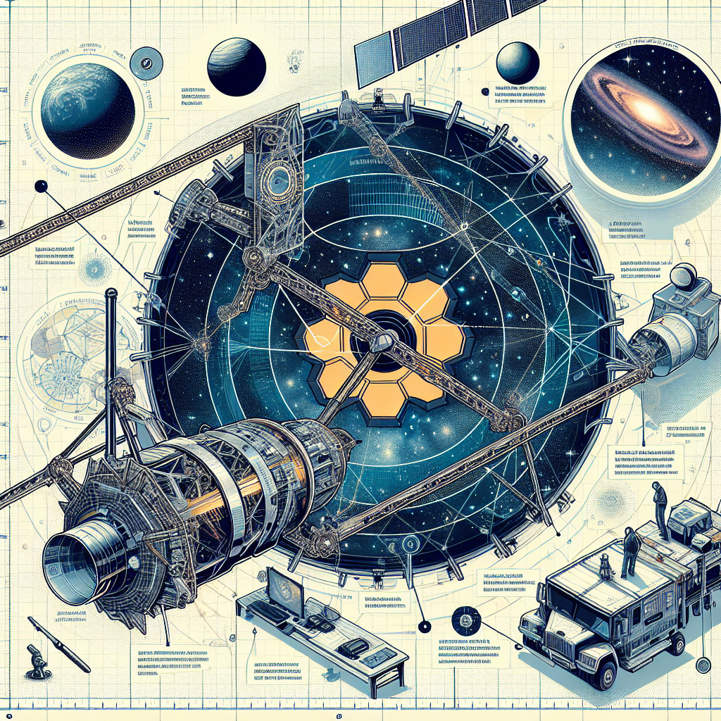
Unveiling the Universe with James Webb Space Telescope
Set to launch in 2021, the James Webb Space Telescope will revolutionize our understanding of the universe
With a primary mirror 2.7 times larger than Hubble's, Webb will observe distant galaxies, stars, and planetary systems in unprecedented detail
The telescope will contribute significantly to the search for extraterrestrial life
It is designed to study the atmospheres of exoplanets meticulously
Examples:
Webb's large mirror allows it to capture more light, enabling it to observe faint and distant astronomical objects
By studying the atmospheres of exoplanets, Webb might detect signs of life such as traces of oxygen or methane
Discussion Questions:
How might the James Webb Space Telescope's findings redefine our understanding of the universe?
What impact could the detection of extraterrestrial life have on our perception of life and our place in the universe?
How does the size of Webb's mirror contribute to its ability to observe distant galaxies and planetary systems?
AI-generated educational illustration for The James Webb Space Telescope's Mission

